Slide 1
Predicting Airline Delay
By: Naufal Fadhilah

Slide 2
01
02
03
04
Data Understanding
Exploratory Data Analysis & Data Pre processing
Machine Learning Model
Conclusion and Recommendation

Slide 3
01
Data Understanding

Slide 4
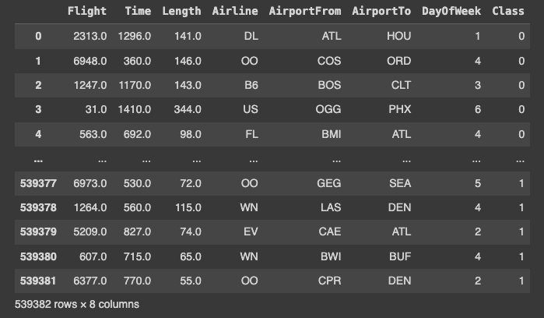
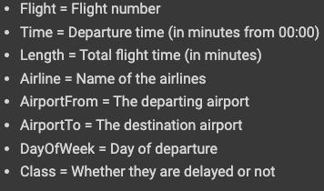
Data Understanding
Obtained through Kaggle, this dataset is about predicting whether the airline will be delayed or not. Where it contains 539.382 data with 8 columns.

Slide 5
02
Exploratory Data Analysis & Data Pre processing

Slide 6
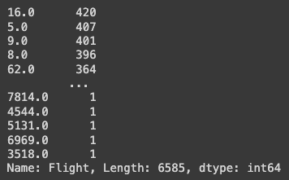
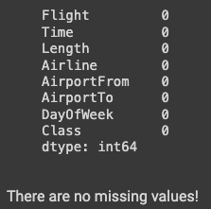
Exploratory Data Analysis & Data Preprocessing
It is found that there are 216618 duplicated data, they all are coming from the flight column.

Slide 7
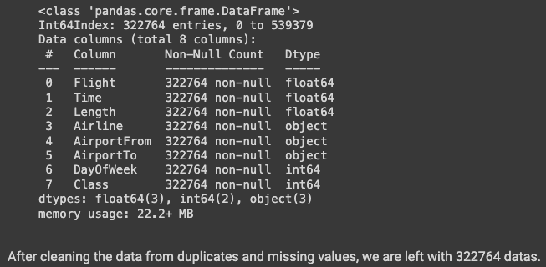
Exploratory Data Analysis & Data Preprocessing

Slide 8
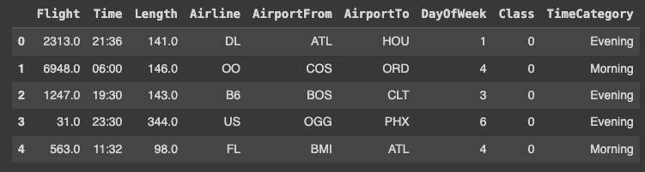
Exploratory Data Analysis & Data Preprocessing
Here Time format from minutes have been turned into HH:MM format. Also a new column called “TimeCategory” has been added.

Slide 9
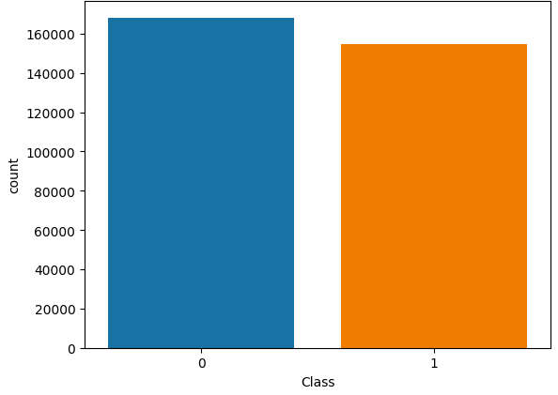
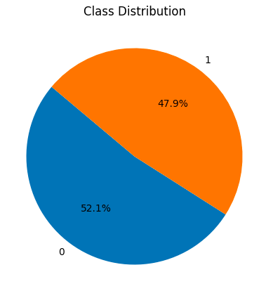

Exploratory Data Analysis & Data Preprocessing

Slide 10
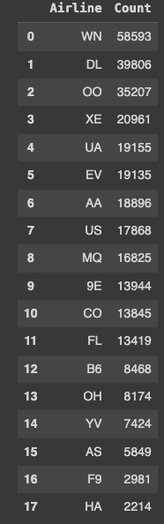
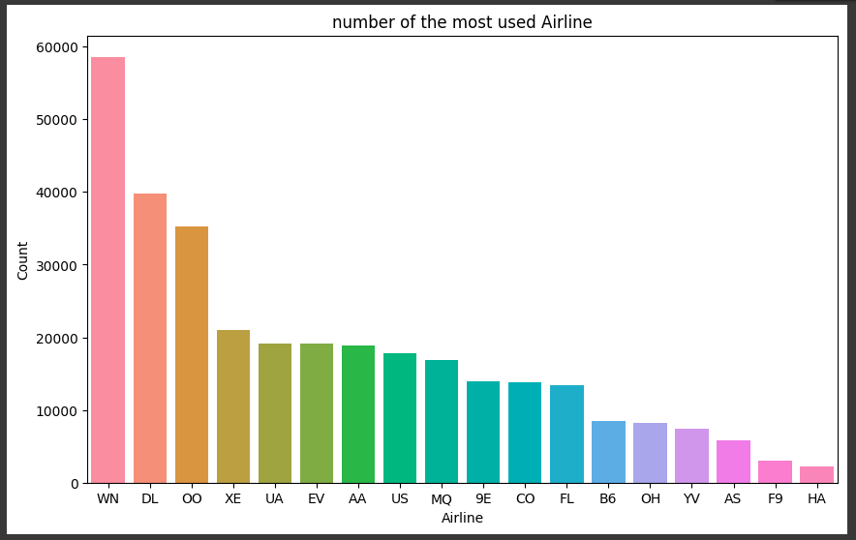
Exploratory Data Analysis & Data Preprocessing
The graph shows the distribution of most used airline, WN being the most and HA being the least.

Slide 11
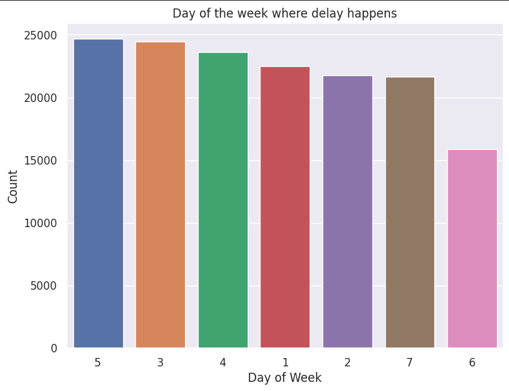
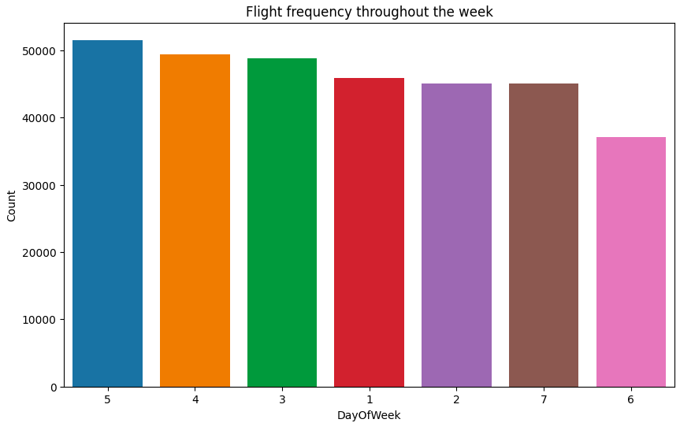
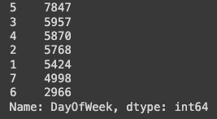
Exploratory Data Analysis & Data Preprocessing
- Flight happens mostly during day 5 and least at day 3
- Delay also happens the most at day 5

Slide 12
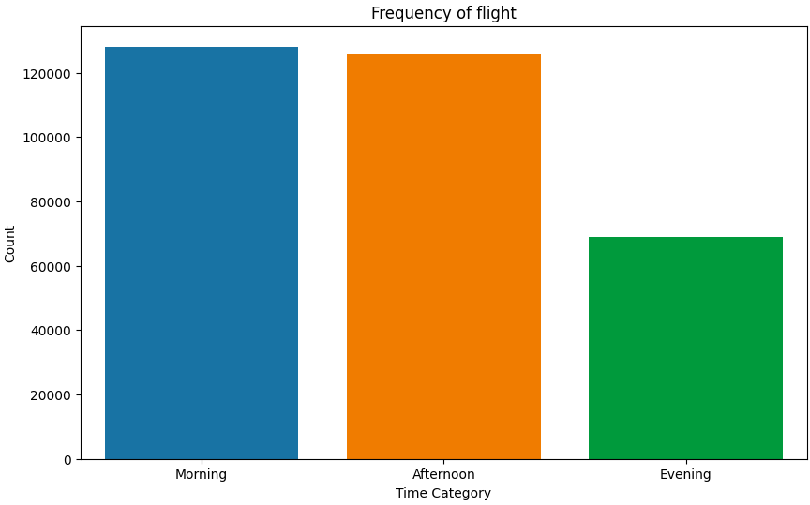
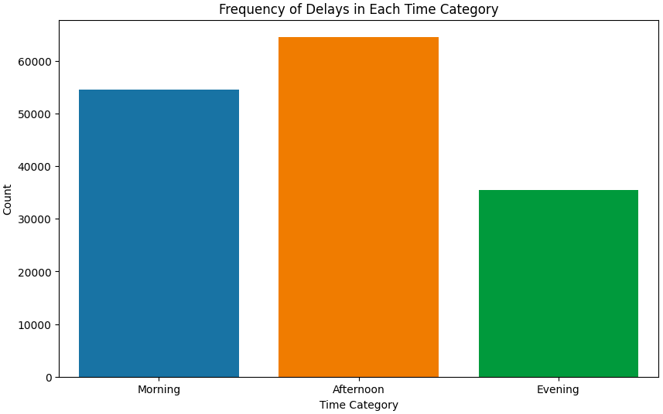
Exploratory Data Analysis & Data Preprocessing
Most flights happens during morning time. However, the most delayed are in the afternoon.

Slide 13
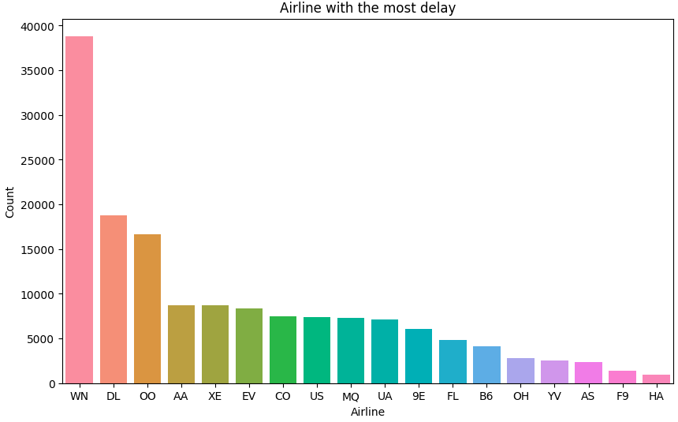
Exploratory Data Analysis & Data Preprocessing
WN is the airline with the most delay, coming in second is DL and the least delay airline being HA.

Slide 14
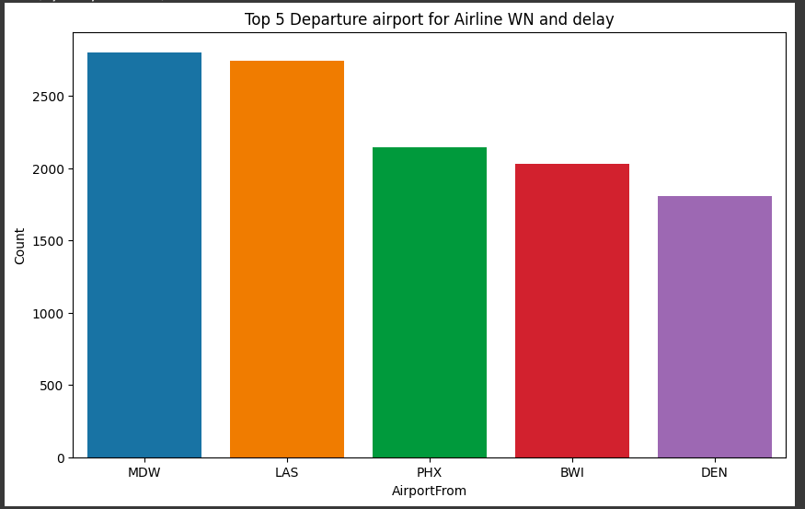
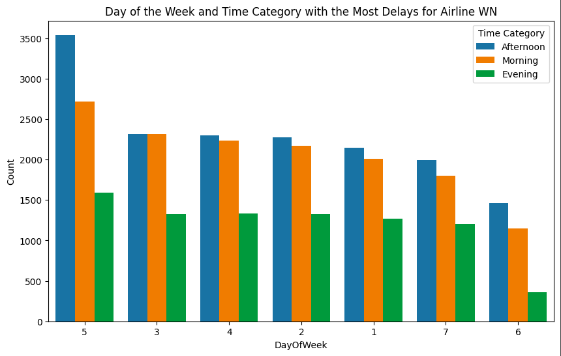
Exploratory Data Analysis & Data Preprocessing
-WN mostly delayed from MDW airport
- Delay occurs mainly on day 5 in the Afternoon while the least being in the evening.

Slide 15
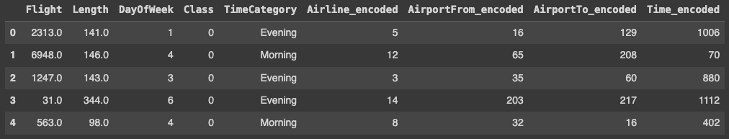
Exploratory Data Analysis & Data Preprocessing
Encoding the classification column (Airline, AirportFrom, AirportTo and Time.

Slide 16
03
Machine Learning Model

Slide 17
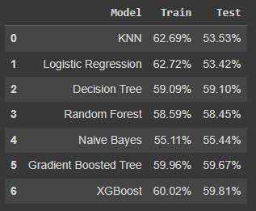
Machine Learning Model
- KNN and Logistic Regression seems toi be overfitting
- Gradient Boosted Tree has the second highest accuracy with 59.81%
- The best model to be used is XGBoost with accuracy of 59.81%

Slide 18
04
Conclusion and Recommendaiton

Slide 19
Conclusion and Recommendation
With this dataset, I ran through numerous different models, thus the model with the highest accuracy score is XGBoost with 59.81% to predict delay. While the lowest being Logistic Regression with an accuracy of 53.42%. However the recall for XGBoost is only 44.62% which is quite low. Thius suggest the model struggles to correctly identify the positive cases. For example in 100 delay it will only identify 39 delays.
Recommendation
- WN needs to add its flights on the evening more
- It is recommended for WN airline to increase its fleet
- Airline need to prepare and compensate the delayed passenger in advance to keep customer satisfaction

